Slide 1
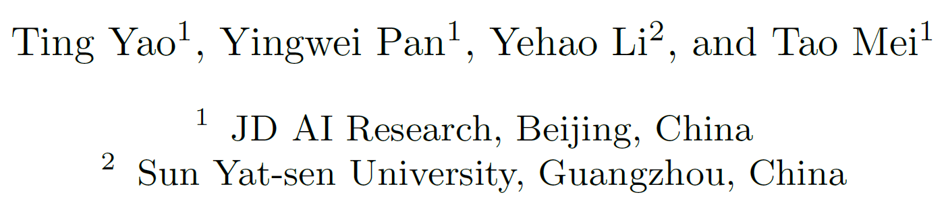
Exploring Visual Relationship for Image Captioning (ECCV 18)

Slide 2
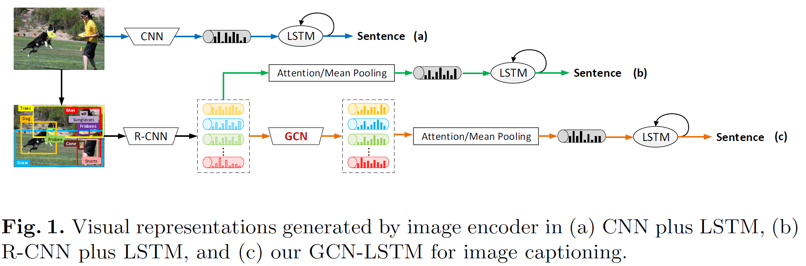
Background

Slide 3
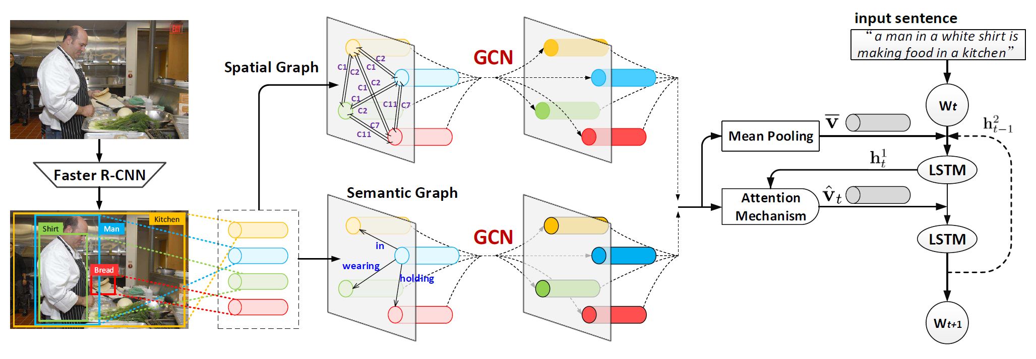
ARCH

Slide 4
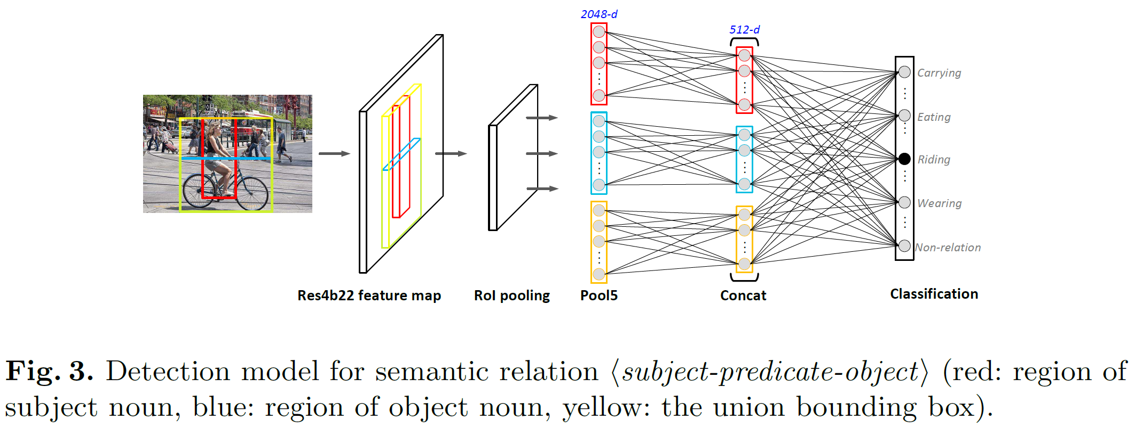
Semantic Relationship Prediction

Slide 5
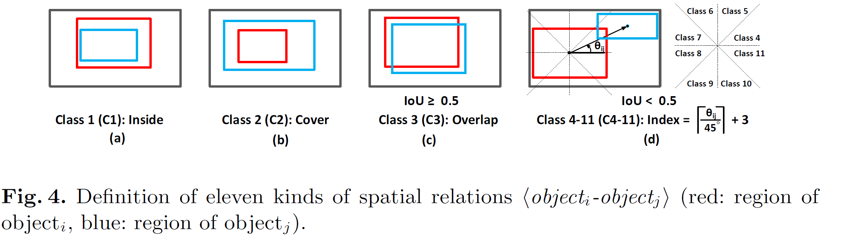
Spatial

Slide 6
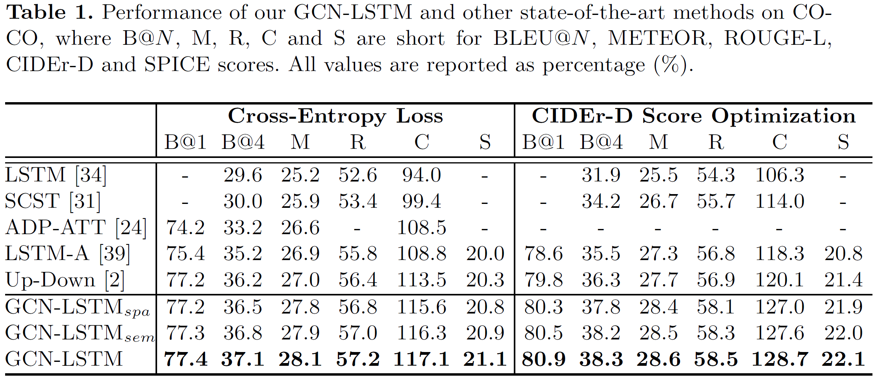
Experiment

Slide 7
Thanks

